Slide 1

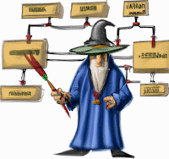
TPM- Proxy
Impossible testing at hand
Notes:
Hi, my name is Enrico Da Ros and this is “The Protocol Master, Impossible testing at hands”
Remove bin and obj from net-core projects
Loaded before all the docker images

Slide 2
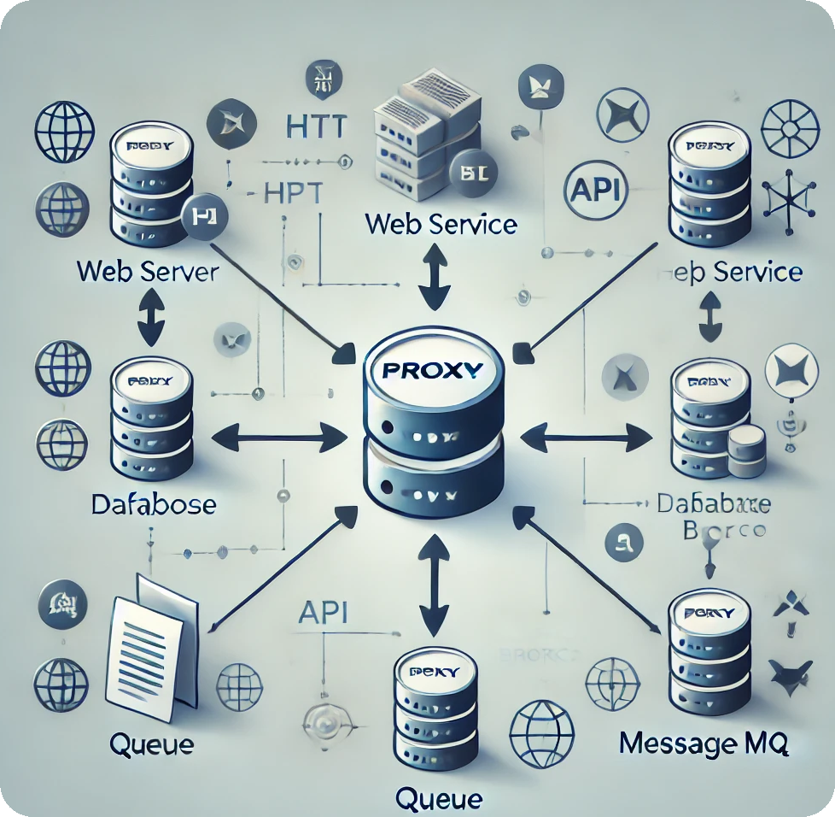
What THE TPM-Proxy IS
The good man-in-the-middle
A software!
A Transparent Proxy
An API Emulator
A Network Packet Analyzer
Notes:
What is The Protocol Master? TPM Is a Transparent Proxy, an Emulator and a Network Packet Analyzer, a simple command line Java application that can be placed between your software and all supported external system as a kind Man-In-The-Middle to log, record, replay and modify all the interactions. Following this approach, you can simulate a whole infrastructure without even coding.

Slide 3
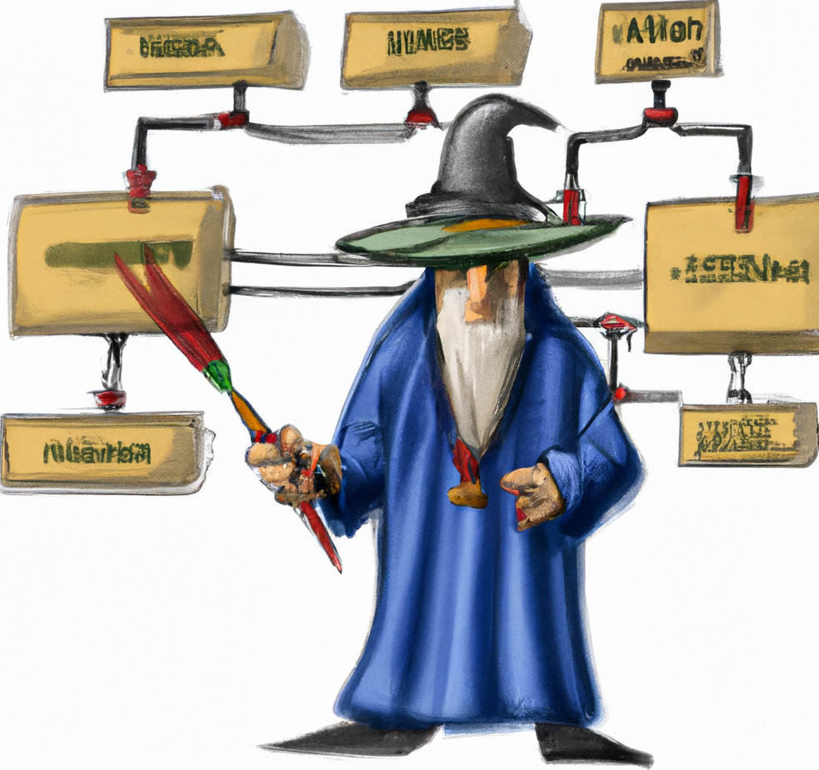
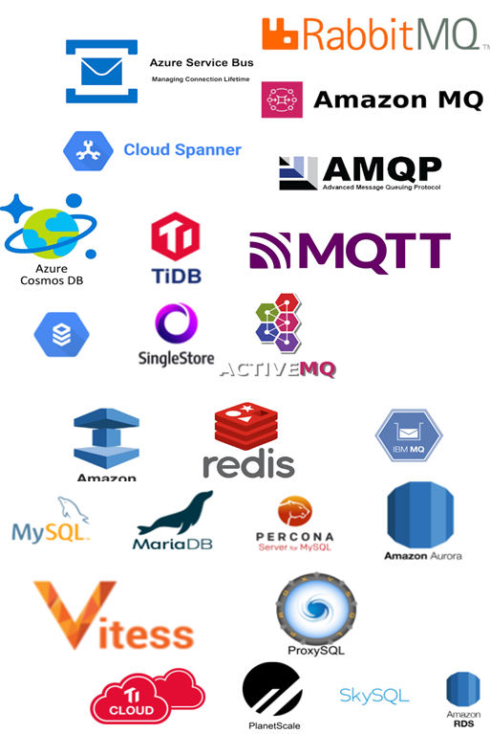
What it does
Simulate errors, rate limiting, responses
Mock entire infrastructures in minutes
Gold standard tests
Simulate non existing APIs
Protocols covered:
HTTP, HTTPS, Soap, REST
MySQL, Postgres, Mongo Db, Redis
AMQP 0.9, MQTT (next in line: Kafka)
Upload complete “scenes”

Slide 4













WHERE CAN be run
Hint: Mostly everywhere, it’s wire protocol ☺
Agnostic in respect of
Language
Infrastructure
Architecture
Run as
Command line
Docker image
Kubernetes
CI/CD Integration
Embedded in Java
Notes:
You can do all of this with TPM and you can do this with your preferred system and architecture.
The system can run locally via command line (leveraging its internal a proxy to record http calls from a browser) or as a Docker image. You can event integrate it in your CI/CD pipeline. All without caring about the Language/Infrastructure/Architecture since the emulation is built upon the –real- wire protocol used by the services emulated.
There will be no difference between calling TPM or a real server. The language spoken is raw TCP data, no need for weird AOP techniques, custom drivers (been there done that…never again). Just use the TPM as a unique entry point exposing all the services you need.

Slide 5
Let’s start!

Slide 6
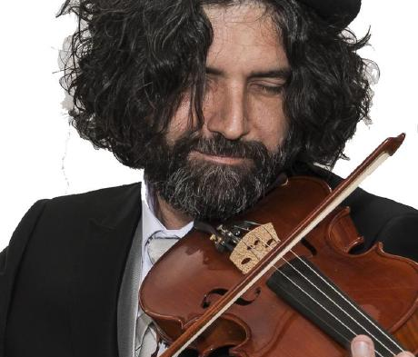
Find out more
http://www.github.com/kendarorg
https://www.linkedin.com/in/enricodaros/
enrico.daros@gmail.com
https://www.kendar.org
Notes:
And here my details:
http://www.github.com/kendarorg
https://www.linkedin.com/in/enricodaros/
enrico.daros@gmail.com
https://www.kendar.org

